Slide 1
Activation Charge Solution - GMSA
Deepak Kumar Sharma
May 03, 2021

Slide 2
Business Requirements
Claro want activation fees to be included in below scenarios –
Scenario 1 - When GM submit the order (Add order) validate that activation fees to be charge or not.
Scenario 2 - Calculate and show associated activation charge for every ICCID in Monthly “Activation fee Report”.
Activation fee Report (monthly) structure should be :-
‘IMSI’ ‘ICCID’ ‘MSISDN’ ‘Activation fee’ ‘product id’ ‘Timestamp’
Scenario 3 - Calculate and show activation charge in monthly Biginvoice Report.

Slide 3
Assumptions
Assumptions – (All are agreed by Claro Team)
There is nothing like discount on “activation fees” (discount on activation fee BRL 44.70).
Activation fees will be charged only once either with ‘Dealer Demo’ or with ‘Data Trial’.
Activation fees is fixed as BRL 44.70 currently.
Activation fees will be applied only when country is brazil.
Activation fee will not be applicable for any other plan except the plans which are under ‘Dealer Demo’ or ‘Data Trial’ plans. (Package ID - GMTR1, GMDD1)

Slide 4
Confirmation required
Confirmation required –
Charge calculation will be done on the basis of last day of the month (30, 31st of the month). CDR will be taken which are before 00:00:00 am of 1st of the month. – Confirmed by Claro
Is there any pro rata calculation need to be performed if customer has changed multiple plans in one billing month/cycle ? No – last state and Plan will be considered.
Processing of monthly file will take 1 day. This is dependent on the CDR availability – Confirmed by Claro
In case there is a delay of more then one day (ex. 5 days), how CDR need to be processed and send ? – Process this in next bill cycle
Can you please provide all product ID which are under ‘Dealer Demo’ or ‘Data Trial’ where activation fee need to apply? (Package ID - GMTR1, GMDD1)
If customer do not use any plan for some months and start using service again, do we need to charge activation fee ? No
In case of resell of car, do we need to charge activation fee ? No

Slide 5
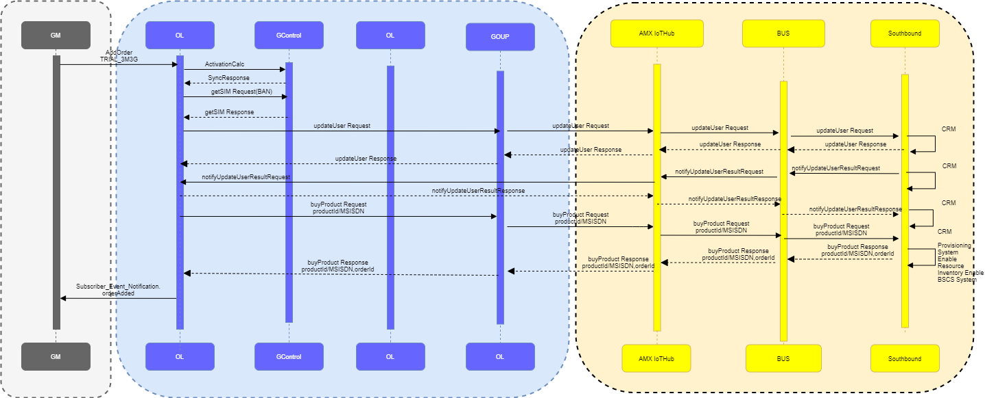
Scenario 1 - Data Trial

Slide 6
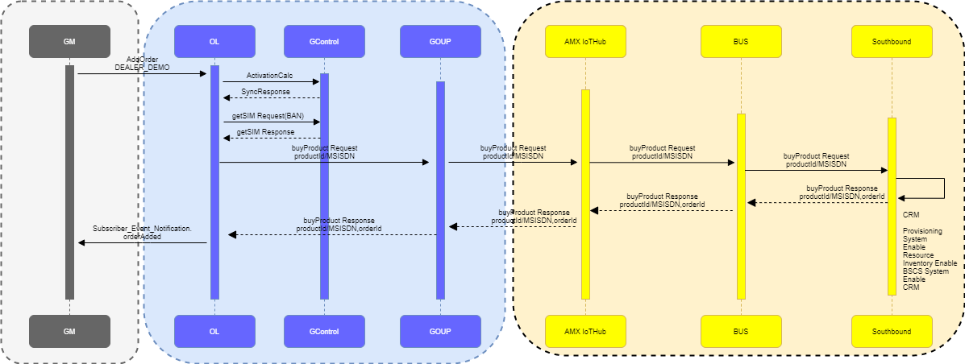
Scenario 1 – Dealer Demo

Slide 7
Possible Solution - Scenario 1
Once AQ receives the “AddOrder”
AQ will validate for Country – if country is ‘Brazil’ then,
Check the product ID if it is GMTR1 or GMDD1 then go to step 3. if product id is not GMTR1 or GMDD1 then do not calculate any activation charge.
Check the entry of SIM in the “actv_charge_ref” table,
If MSISDN is not found. Wait for the ‘buyproduct’ response.
If ‘buyproduct’ success response received, then Calculate the activation charge as full (BRL 44,70) and create the entry in “actv_charge_ref” table.
If ‘buyproduct’ failure response received, then do nothing.
b. If MSISDN found in “actv_charge_ref” table do nothing ( do not calculate any activation charge).
Note –
Entries which are created in the “actv_charge_ref” table will be used at the time of monthly calculations.
“actv_charge_ref” table Structure is (MSISDN, Timestamp, productid, activation_fee).

Slide 8
Prerequisite
Claro need to share
The table “actv_charge_ref”. Table Structure should be as (MSISDN, Timestamp, productid, activation_fee).
Note -
Once AQ receive this table only after that activation charge calculation can be provided.
Timestamp format should be YYYY-MM-DD HH:MM:SS

Slide 9
Scenario 2
Activation fee will be calculated in Monthly “Activation fee report” using “actv_charge_ref” Table.
MSISDN will have the mapping with the “activation_fee” with the date (timestamp).
Script should check if date of “activation fee” falls under the billing cycle.
If Yes then, reflect the “activation fee” from ‘actv_charge_ref’ table in Monthly “Activation fee report”.
“Activation fee report” will have - ‘ICCID’ ‘IMSI’ ‘MSISDN’ ‘ACTIVATION_FEE’ ‘PRODUCT_ID’ ‘TIMESTAMP’ fields as column.
Sample –
File name – “Gcontrol_20210501_MonthlyActivationFeeReport_100259213_165545787692”
Frequency – Monthly
Type of file - .csv

Slide 10
Scenario 3
Activation charges will be calculated in Monthly biginvoice report using “actv_charge_ref” Table.
MSISDN will have the mapping with the “activation_fee” with the date (timestamp).
Script should check if date of “activation_fee” falls under the billing cycle.
If Yes then, reflect the “activation fee” from ‘actv_charge_ref’ table in Monthly biginvoice report.
New row will be added for activation fee in Biginvoice report.

